Slide 1
Bandwidth Monitoring & Measurement
(tools and services)

Slide 2
In this presentation
Introduction
What are Network Monitoring Tools
Bandwidth Monitoring Techniques/Services
Setting up some monitoring Tools
Conclusion

Slide 3
Introduction:- Why do we need to monitor and measure Bandwidth
Cost of Bandwidth is expensive for developing countries
    Bandwidth in developing countries is expensive. In a report for the Partnership for Higher Education in Africa, Mike Jensen calculates that Makerere University pays about
    $22,000/month for 1.5Mbps/768Kbps (in/out), Eduardo Mondlane pays $10,000/month for 1Mbps/384Kbps, while the University of Ghana pays $10,000/month for 1Mbps/512Kbps.
    These figures indicate that African universities, outside of South Africa, are paying over $55,000/month for 4Mbps inbound and 2Mbps outbound. These figures are about 100 times more expensive than equivalent prices in North America or Europe.

Slide 4
Cont…
To Know if the ISP is providing us with the required bandwidth paid for.
To be able to optimize the available bandwidth
  59% of institutions do not monitor or manage bandwidth at all (Belcher, 2005)
  For details See the ATICS Report: www.atics.info
Notes:
African research and Education Networking 25-27 sept. 2005 CERN

Slide 5
Ways to improve network performance
Upgrade infrastructure, to install faster, larger, and higher performing systems, lines and facilities.
Look for cheaper provider and Increase/upgrade your bandwidth.
Alternative approach
  is to recognize that ‘bandwidth’ is a valuable institutional resource or asset that needs to be managed, conserved, and shared as effectively as possible.

Slide 6




How do we measure Bandwidth?
Network Monitoring Tool

Slide 7
What are Network Monitoring Tools?
Allows the administrator to know the health status of the network.
It provides information about collected data and the analysis of such raw data with a view to using scarce or limited resources effectively.
Uses network probe. Probes let you isolate traffic problems and congestions slowing your network to a crawl.

Slide 8
What can we use the tools for?
Identifying unofficial services or servers
Monitoring usage and traffic statistics
Troubleshooting your network
Investigating a security incident
Keeping logs of users activities for accountability

Slide 9
Who? What? Where? How? When?
Who is accessing your network?
  students, academics, staff, visitors or others
What are they accessing your network for?
  academic study, social use, business use, illegal use
Where are they accessing your network from?
  internal, external
How are they accessing your network?
  remote user, local Ethernet, WAN, dial-up, Wi-Fi, VPN
When did they access your network?
  today, yesterday, last week, last month…

Slide 10
Network Monitoring Techniques
Fraleigh et al, (2001) describe two techniques for network measurement.
Active Measurement
Passive Measurement
Notes:
Design and Development of Passive monitoring infrastructure

Slide 11


Active vs. Passive
Active – relies upon data gathered from probe packets injected into the network.
Passive – relies upon data gathered from active network traffic.

Slide 12


Active and Passive Tools
Network Monitoring Tools
http://www.slac.stanford.edu/xorg/nmtf/nmtf-tools.html#ping

Slide 13
Passive Network Monitoring Tools
Multi-Router Traffic Grapher
Is a tool for monitoring traffic loads on a network link. MRTG generates HTML pages that provide a live, visual representation of the network traffic.
It can be used to monitor any SNMP MIB.
Limitations
  It cannot provide information that shows which host or application may be causing a traffic bottleneck.
  MRTG does not provide information about traffic type or protocol statistics

Slide 14
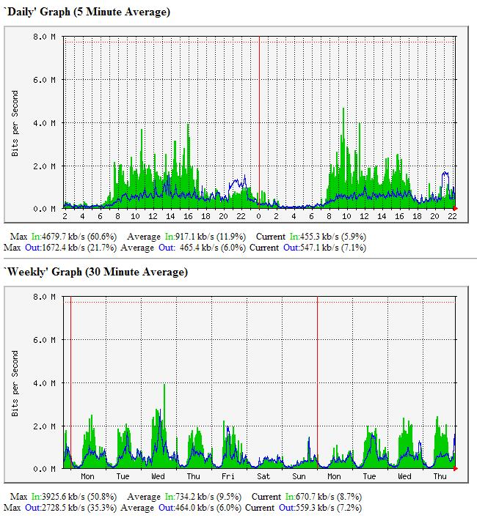
MRTG Example
MRTG Example

Slide 15
Cont…
Etherfind
  The software opens the network card in the promiscuous mode and writes a summary line of each packet to a file.
  Information include protocol type, size, source and destination addresses.
  The tool extract information from each packet. The data is presented as a text-based user interface
  Only users with root permission can access the tool.

Slide 16
CONT……
NFS watch
  It monitors all incoming network traffic destined to NFS file servers, and divides it into several categories. The number and percentages of packets received is displayed on the screen
  This tool was originally designed to monitor a single host

Slide 17
CONT…
TCPdump
  Uses the packet capture library (libpcap).
  Prints the headers of packet on a network interface, user analyses network status using this header manually
  Has many option for capturing raw data, but it does not provide any analysis capability for the captured data.

Slide 18
CONT…..
Argus
- It is a generic auditing tool.
- It runs as an application level daemon, promiscuously reading network packets from a specified interface
- it generate network traffic audit records for the network activity.
- it extract info from each packet in promiscuous mode, save the info to a file and later analyzes the file
- It shows information about protocols, but does not show source or destination host information, it only provides a text based user interface.

Slide 19
CONT…
Etherload
  It is a freely LAN traffic analyzer for MS-DOS with an Ethernet or Token Ring controller
  It basically captures each packet running through a LAN and provides various information on the packet.
  It can be used to check which host is generating the most traffic, which host is sending to which host, and what kind of protocols are in use in a specific Ethernet segment
  Since it is DOS based it provides character-based user interface for displaying traffic information

Slide 20
CONT…..
IPTraf
  IPTraf is a console-based network statistics utility for Linux. It gathers a variety of figures such as TCP connection packet and byte counts, interface statistics and activity indicators, TCP/UDP traffic breakdowns, and LAN station packet and byte count
  Protocols Recognized
  IP
  TCP
  UDP
  ICMP
  IGMP
  IGP
  IGRP
  OSPF
  ARP
  RARP

Slide 21
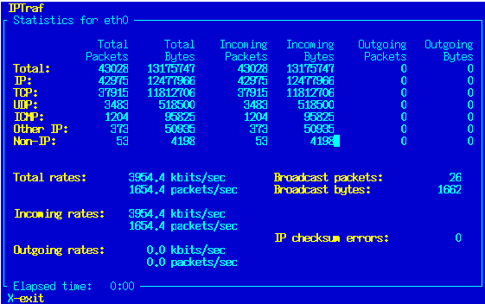

Slide 22
CONT……
NTOP
  ntop is a network traffic probe that shows the network usage, similar to what the popular top Unix command does. ntop is based on libpcap and it has been written in a portable way in order to virtually run on every Unix platform and on Win32 as well.
  ntop users can use a a web browser (e.g. netscape) to navigate through ntop (that acts as a web server) traffic information and get a dump of the network status.

Slide 23
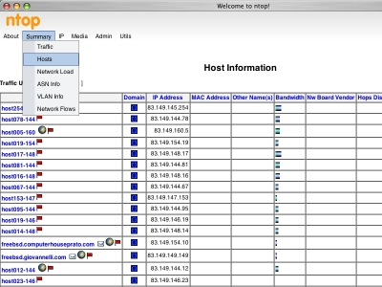

Slide 24
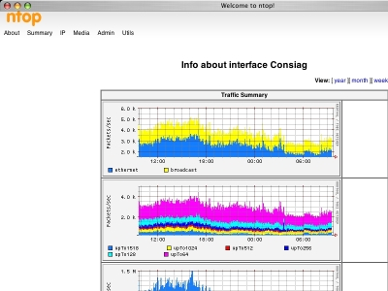

Slide 25
CONT…
PRTG
  PRTG Traffic Grapher is an easy to use Windows software that monitors bandwidth usage and other network parameters via SNMP.
  PRTG Traffic Grapher monitors network and bandwidth usage as well as various other network parameters like memory and CPU usages, providing system administrators with live readings and periodical usage trends to optimize the efficiency, layout and setup of leased lines, routers, firewalls, servers and other Simple Network Management Protocol (SNMP) enabled network components.

Slide 26
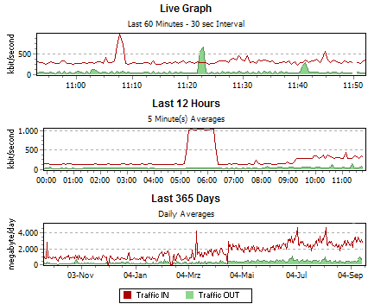
PRTG Example

Slide 27
CONT…
Webalizer
  The Webalizer is a fast, free web server log file analysis program. It produces highly detailed, easily configurable usage reports in HTML format, for viewing with a standard web browser.

Slide 28
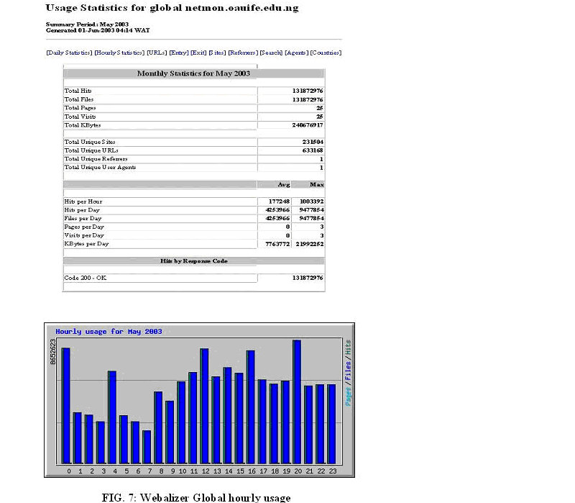
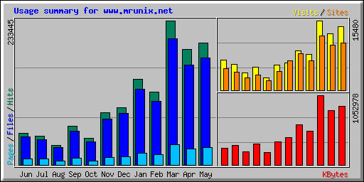

Slide 29
CONT…
WebTrafMon
  Web-based network traffic monitoring and analysis system.
  Displays a list of hosts that are currently using the network and reports information concerning the IP(Internet Protocol) traffic generated and exchanged by each host.
  Limitations….
Can not Monitor and analyze the Fast Ethernet and Gigabit Ethernet
Can not Analyze large log files

Slide 30
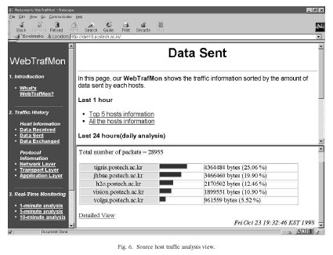

Slide 31
Bandwidth measurement services
http://www.2wire.com/?p=154
http://www.speakeasy.net/speedtest/http://www.ookla.com/speedtest/
http://reviews.cnet.com/7004-7254_70.html?tag=txt
http://us.mcafee.com/root/speedometer/default.asp
http://www.zapp.ro/buy/speedmeter/
http://www.bandwidthplace.com/speedtest/
http://reviews-zdnet.com.com/Bandwidth_meter/7004-7254_16-0.html
http://bluefield.speedtest.frontiernet.net/ Bluefield WV http://bos.speakeasy.net Boston, speakeasy bandwidth speed test http://box54.org/SpeedTest.html Box 54 Server http://bugclub.org/BUGSpeed.html Brevard Users Group server Speed Test http://chi.speakeasy.net Chicago, speakeasy networked server speed test http://cookeville.speedtest.frontiernet.net/ Cookeville TN http://den.speakeasy.net Denver, speakeasy bandwidth speeds http://dfw.speakeasy.net Dallas, speakeasy bandwidth speeds http://download.enitel.no/speedtest/ Speed test - text download, Norway
http://elkgrove.speedtest.frontiernet.net/ Elk Grove CA (Nice test site)
http://gemal.dk/browserspy/bandwidth.html BrowserSpy, How fast is your connection...
http://home.austin.rr.com/bc/bandwidth.htm RoadRunner of Austin, Texas http://home.broadpark.no/~tbjorgen-1/speedometer.html Lars-Magnus Lier http://home.cfl.rr.com/bjp/test.htm Brad's RoadRunner networked server speeds http://home.cfl.rr.com/cm3/speedtest7.htm Corley's RoadRunner Test page http://home.cfl.rr.com/eaa/SpeedTest.htm Eric's own RoadRunner Bandwidth Test http://homepage.tinet.ie/~leslie/testpage.htm 2 tests available.
http://support.sbcglobal.net/dsl/speedtest/ http://us.mcafee.com/root/speedometer.asp Mcafee's SpeedOmeter (resurrected) http://w1.970.telia.com/~u97007522/ Speed test, Located in northern Sweden http://web.bitnet.net/dimension/ (Sweden - Borlange) http://web.bitnet.net/dimension/speedtest.htm Sweden, bandwidth speedtest http://web.tampabay.rr.com/giis/50.htm RoadRunner of Tampa Bay, FL http://webservices.cnet.com/Bandwidth/?tag=tm CNET's test. http://www.2wire.com/meter/bm.html 2Wire Bandwidth Meter. http://www.2wire.com/meter/bmresult.html?kbps=1863 2Wire Bandwidth Meter. http://www.aitsoft.com/Services/speedtest.asp AIT -- Services -- Speed Test http://www.alken.nl/ Online Speedtest etc. http://www.aroundcinci.com/speedtest/ speedtest home of Cincinati, Ohio http://www.austin.rr.com/speedtest/speed.asp RoadRunner home of Austin, Texas http://www.bandwidthplace.com/speedtest/ Bandwidth Place Welcome! http://www.beelinebandwidthtest.com/ Beeline Bandwidth Test, Amsterdam http://www.cable-modem.net/features/oct99/speed.html bandwidth speedtest http://www.computers4sure.com/speed.asp?iid=154 By mhmd, 4SURE.com bandwidth http://www.dagbladet.no/dinside/baandbredde/start.html Norway http://www.donspage.com/dsltest/speedtest.html online services bandwidth speed test http://www.dslreports.com/stest?loc=1 DSL Reports in Megapath, CA

Slide 32
Cont…
http://www.eaglepro.net/bandwith/ Sweden bandwidth speed test http://www.ececs.uc.edu/~annexste/speed.html internet performance speedtest http://www.ececs.uc.edu/~annexste/speed100.html University of Cincinnati http://www.elkindustries.com/SpeedTest.htm Elk Industries Server Test http://www.info-techs.com/speedtest.html Information Technologies http://www.info-techs.com/speedtest50.html Lakeview Terrace, CA http://www.info-techs.com/speedtest500.html Lakeview Terrace, CA http://www.intercom.net/xpeedometer/xpeedometer.htm http://www.itcom.itd.umich.edu/adsl/speedtest.html broadband connection test http://www.midsouth.rr.com/speed.asp RoadRunner of the Mid-South Speed Test http://www.mordax.nl/ Netherlands internet speedtest http://www.numion.com/YourSpeed/Checkup.php?L=br connection performance http://www.numion.com/YourSpeed/Checkup.php?L=tw United Kingdom http://www.pcpitstop.com/internet/Bandwidth.asp speed test page for Fort Wayne,IN http://www.pcpitstop.com/internet/default.asp PC Pitstop's Internet Connection Center http://www.satx.rr.com/support/speedtest/ RoadRunner Speed Tests http://www.speedsuite.net/speedsuite/ Networked Speed test, Amsterdam http://www.speedtest.nl/ Netherlands http://www.squigly.com/performance/ cable speeds near Toronto, Canada http://www.summitcomputer.net/speedtest/unlisted/speedtest500.asp http://www.testmy.net/ Bandwidth Speed Test & Broadband Forum-Chat http://www.zensupport.co.uk/speedtest/ Zen's Web test http://speed.kify.com/
http://speedtest.csloxinfo.com/
www.adslthailand.com/bandwidthmeter/initialmeter.php
http://wow.asianet.co.th/speedtest.php
http://203.147.12.250/bwtest/initialmeter.php
http://bandwidth.west.cat.net.th/meter.php
http://media.thai2learn.com/meter/initialmeter.php
http://www.ine.co.th/support/speed/meter.php
http://wow.trueinternet.co.th/speedtest.php

Slide 33
Setting up Ntop
Download Ntop
Using a tar ball
      tar xpfz ntop-3.0-4.tar.gz
      ./configure
      make
      make install
http://rpm.pbone.net
Installing with RPM is also easy. The package name may vary, but you simply use the command:
    rpm –uvh ntop-3.0-4mdk.i586.rpm
Run ntop (service ntop start)
Go to a web browser type http://localhost:3000

Slide 34
Setting up MRTG
Net-snmp
Mrtg
Snmpd.conf
# define RO community
rocommunity bow
rwcommunity bow
#First Map the community name “bow" into a "security name“
# sec.name source community
com2sec oaunet default bow
# Second, map the security name into a group name:
# groupName securityModel securityName
group oaugroup v1 oaunet
group oaugroup v2c oaunet

Slide 35
Snmpd.conf cont…
# Third, create a view for us to let the group have rights to:
# name incl/excl subtree mask(optional)
#view systemview included system
view all included .1 80
# Finally, grant the group read-only access to the systemview view.
# group context sec.model sec.level prefix read write notif
access notConfigGroup "" any noauth exact systemview none none

Slide 36
Sample snmpd.conf file
rocommunity bow
com2sec local localhost bow
com2sec mynetwork 10.105.1.0/24 bow
group myRwgroup any local
group myRogroup any mynetwork
view all included .1 80
access myRogroup "" any noauth all none none
access myRwgroup "" any noauth all all all

Slide 37
Start your Snmp server and test it
# chkconfig snmpd on
Start the service snmpd (#service snmpd start)
Run snmpwalk utility to request for a tree of info about network entity (query snmp server for your IP address assigned to etho, eth1, lo)
#snmpwalk -c bow -v 1 localhost

Slide 38
Install mrtg
Installing with RPM is also easy. The package name may vary, but you simply use the command:
    rpm –Uvh mrtg-2.10.5-3mdk
    Create a work directory
    mkdir /var/www/mrtg
    chmod 755 /var/www/mrtg
    Create the mrtg configuration file
# cfgmaker --global "WorkDir: /var/www/mrtg" \
--global "Options[_]: growright,bits" \
--ifref=ip \
bow@localhost > mrtg.cfg

Slide 39
Run mrtg using the Configuration file
#mrtg /var/www/mrtg/mrtg.cfg
Note: You may get few warning message for first time; ignore them. Run mrtg
about 3 times
View the graph using a browser
  file//mrtg

Slide 40

THANK YOU

